Slide 1
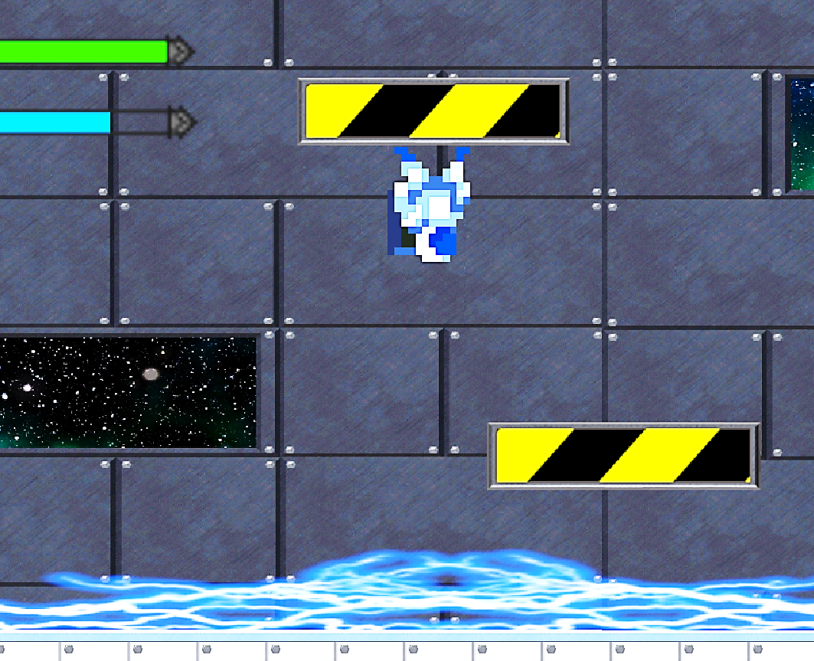
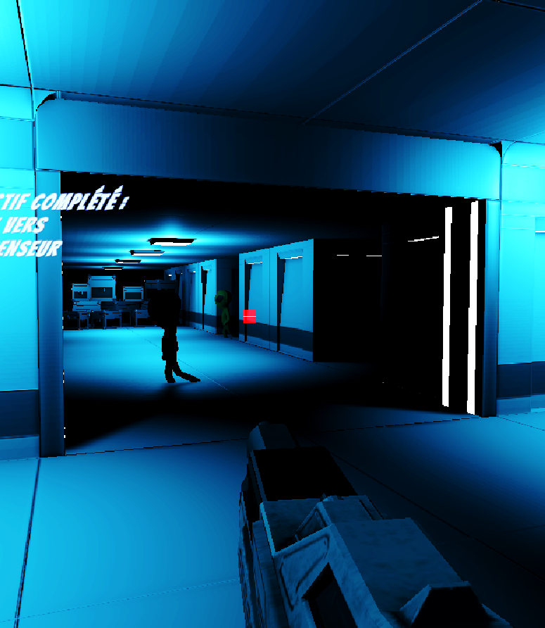
ALPHA ΩMƎGA INVƎЯSI Ω N

